Slide 1

Issues in Document Security:
Discovery, Research, and Experimental Analysis
of Malware (DREAM)
Charles Nicholas, Cynthia Matuszek, Robert Joyce, Ran Liu,
Maksim Erem, Edward Raff
Department of Computer Science and Electrical Engineering
University of Maryland, Baltimore County (UMBC)
Adapted for CMSC 491/691 Active Cyber Defense
Notes:
Thanks for the kind introduction!

Slide 2
Issues in Document Security:
Discovery, Research, and Experimental Analysis of Malware (DREAM)
Issues in Document Security:
Discovery, Research, and Experimental Analysis
of Malware (DREAM)
Charles Nicholas, Cynthia Matuszek, Robert Joyce, Ran Liu,
Maksim Erem, Edward Raff
Department of Computer Science and Electrical Engineering
University of Maryland, Baltimore County (UMBC)
Document Engineering 2025 Keynote
Notes:
Thanks for the kind introduction!

Slide 3

DREAM Lab
We work at the intersection of data science
and cyber security – hot topics!
  Machine learning and malware analysis,
  to be precise
  We present an overview of our recent
  work, and some comments on what is
  coming in the future
  I don’t wear suits very often ☺
Notes:
When you’re invited to give a keynote address, you’re also being invited to take a longer-range view, backwards and forwards, on the work you (and your students) have done

Slide 4
We are working on several topics
Credit for the work described here belongs to our brilliant and hardworking grad students!
  By shamelessly stealing borrowing information, from their recent talks as needed
  Topics: malware datasets, PDF, and tensor decomposition
  All the topics can be viewed from a document engineering perspective
Notes:
Several areas of work, but we select three

Slide 5
1. Datasets for Cybersecurity Research
  If you have data, you can analyze that data, do statistics, and in general be a scientist!
  Several web sites make cyber data available, but
    SecRepo.com - Samples of Security Related Data has a lot of variety, but thin on documents
    VirusTotal.com – lots of malware, but expensive
    IEEE DataPort – has lots of data ☺
Notes:
Area the First – Datasets for Cyber
IEEE Data pot would be a gold mine for MS thesis students

Slide 6
Datasets for Malware Research
  Lots of malware is available for study, but
    Labeling that data is costly
    We want to study malware families, and malware varieties, rather than individual specimens
  Building a malware repository can be complicated!
    More than just a bunch of program files ☺
    Compound docs - long-term interest of ours
    Parallels to Information Retrieval abound
Notes:
Roughly one million new malware specimens are generated PER DAY
But much of it is similar to malware we may have already seen
Compound docs – share an MD5 or SHA1 hash, BUT includes output from tools, sandbox reports, and whatever

Slide 7
Questions Related to Malware
Is a given binary malicious or benign?
If malicious, what form of malware is it, or to which malware family does it belong?
A malware classifier will answer such questions
Notes:
Among the first questions, is it REALLY malware, and if so what kind?

Slide 8
Evaluation of Malware Classifiers
A malware classifier tries to say whether a given binary is malicious or benign, and if malicious, what form of malware is it, or to which malware family it belongs
Lots of malware classifiers are available, or you can have one built for you!
But that raises the question: How well is your malware classifier working? How do you know?
Notes:
By the way, a simple string pattern matcher like YARA can do some of this, but not all

Slide 9
Evaluation of Malware Classifiers
To evaluate a malware classifier, benchmark datasets including both positive and negative (i.e. malicious and benign) examples are needed.
So, we need a principled way of building such datasets:
  “MalDICT: Benchmark Datsets on Malware Behaviors, Platforms, Exploitation, and Packers”, R. Joyce, E. Raff, C. Nicholas, and J. Holt, CAMLIS, October 24-25, 2023 (link)
  and more recent work presented at KDD’25
Notes:
How do we evaluate a Malware Classifier? The work that follows was presented at CAMLIS’23

Slide 10
Malware Classification Tasks
Although most work on malware classification focuses on benign/malicious classification and family classification
We identify four other classification tasks that we believe are important but under-explored:
  Behavior or malware category
  File format, target OS, or programming language
  Vulnerability that is exploited
  Malware packer (surprisingly hard?)
Notes:
Malware often belongs to several categories
Vulnerability that is exploited, if any!
Custom packers abound
This info belongs in any malware repository!

Slide 11
Prior Labeled Malware Datasets
Labeled benchmark datasets for these four uncommon tasks have limitations or are nonexistent
  SOREL has 10 million malware files and 11 behavioral tags
No publicly-available malware datasets are labeled by platform, vulnerability, or packer – until recently (i.e. EMBER 2024)
Notes:
There have been labeled data sets, but are too small, too old, or lack info we want

Slide 12
Our Approach: Mine AV Scan Reports
Building any large dataset by hand is not practical, so we need to automate somehow.
Aha! Given some executable binary that we might consider for inclusion in a benchmark data set,
  See what VirusTotal makes of it
  Keep the report, and extract “tokens” from it
  These tokens are, of course, not standardized at all ☹
Notes:
So mine VirusTotal!

Slide 13
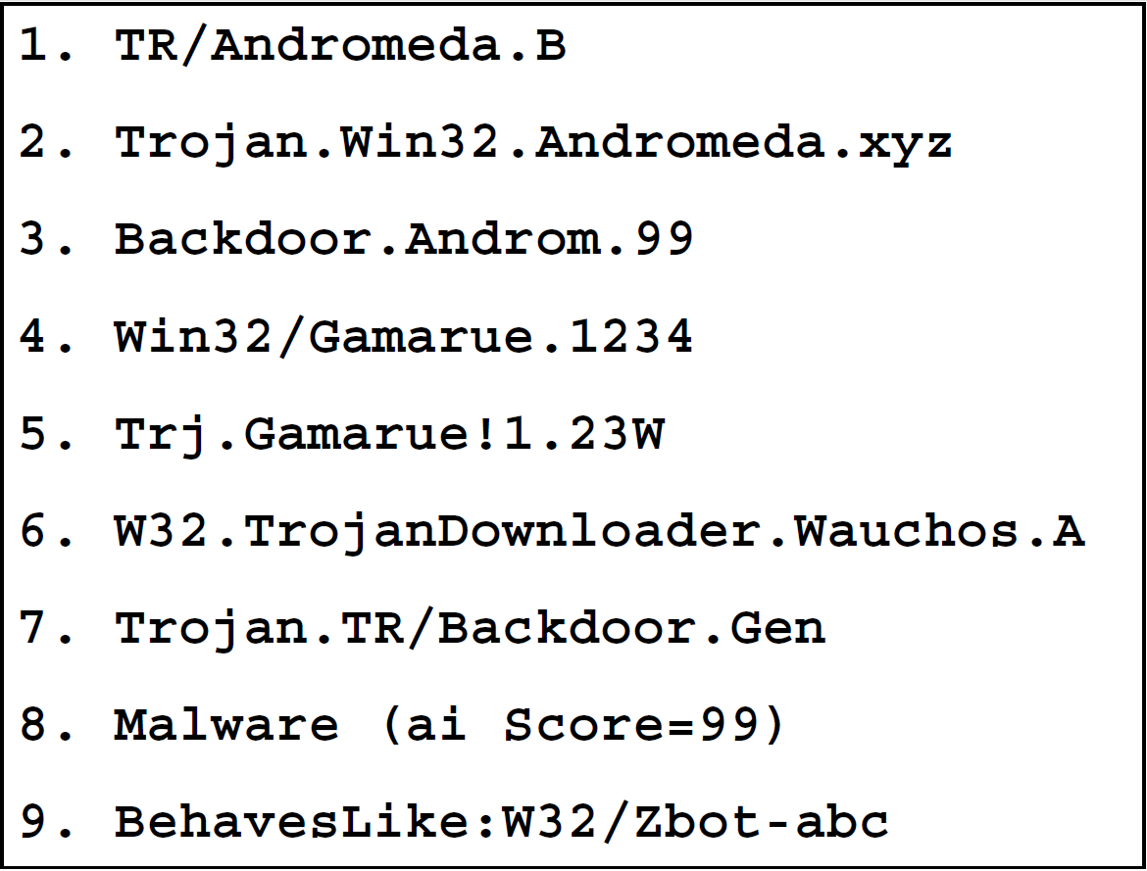
Tagging Malware Using AV Scan Reports
VirusTotal will scan the file with
a collection of AV products
Each product generates an AV
label describing the file
Can include behavior, platform,
exploit, and packer information
Use these labels to classify the
suspect file
Notes:
VT is an ensemble of many (50-100) commercial malware detectors, and it gives aggregate results

Slide 14
Improving AV-Based Tagging
We created a new AV-based malware tagger called ClarAVy
  “Clarifying noise in AV scan data”
ClarAVy works by parsing AV labels, and using a taxonomy to standardize the information returned by VirusTotal
We used ClarAVy to create a benchmark dataset tagged by category, platform, vulnerability, and packer
Notes:
This parsing of VT reports is automated, with ClarAVy

Slide 15
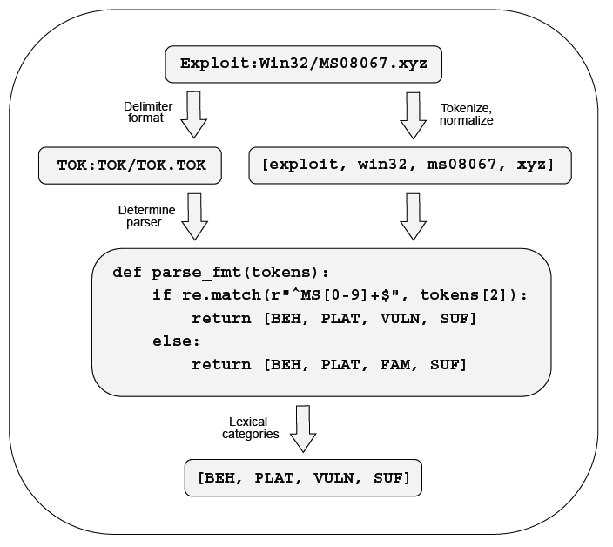
ClarAVy AV Label Parsing
ClarAVy supports parsing 882 AV label formats across 90 different AV products
Parsers were developed with 40 million VirusTotal scans
Coverage for 99.5% of our 1.1 billion AV labels

Slide 16
Malware Datasets for Infrequent Classification Tasks
Once we were confident that ClarAVy was working,
We used the VirusTotal API to collect over 40 million AV scan reports for chunks 0 – 465 of the VirusShare dataset
Then we tagged all of this malware using ClarAVy
  discarded tags which were too rare and down-sampled tags which were too common
Focus on tags related to behavior, platform, vulnerability, and packer
Notes:
VirusSHare is a LARGE set of malware specimens, readily available, but not much with it

Slide 17
Contributions
We’ve shared ClarAVy on GitHub
  https://github.com/NeuromorphicComputationResearchProgram/ClarAVy
Releasing file hashes and ClarAVy tags for MalDICT
  More than 5.5 million tagged malware samples
Releasing disarmed executables and EMBER feature vectors for all PE files in MalDICT
Alas, researchers including ourselves have reason to avoid making live malware specimens easily available
Notes:
ClarAVy is freely available, along with MalDICT

Slide 18
Recent Developments
Joyce et al, “EMBER2024 - A Benchmark Dataset for Holistic Evaluation of Malware Classifiers” (link)
  Metadata, feature vectors, hashes, but not binaries
  Code to allow the dataset to be updated (!)
  Example classifiers (!)
  Presented at KDD in Toronto, July 2025
(still placing emphasis on static analysis)
Notes:
Recent work

Slide 19
Ongoing work, and remarks
More datasets are in progress
Static data is much easier to get than dynamic data,
  Which refers to data collected while the malware is running
  In general, dynamic analysis needs more work, but that would be outside the scope of this talk – I think
Students can use each others’ datasets!
Notes:
We’re building more research data sets!

Slide 20
2. Not all malware abides in EXE files
In fact, much malware targets Android, iDevices, web users, and the Internet of Things ☹
As well as documents, Word and PDF ☹
Word to the wise: open all documents inside a VM!
  PDF files are a malware attack vector!
  Dr. Ran Liu looked at malicious PDF files (DocEng’23 and ‘24)
We need data sets!

Slide 21

PDF Files Can Be Tricky!
According to the ANY.RUN sandbox roughly 1/3 of malware uploaded for inspection is either a Word or PDF document
Optional live demo of ANY.RUN
  https://app.any.run/submissions
Or scan this code with your phone
Example of ANY.RUN output on next
slide

Slide 22
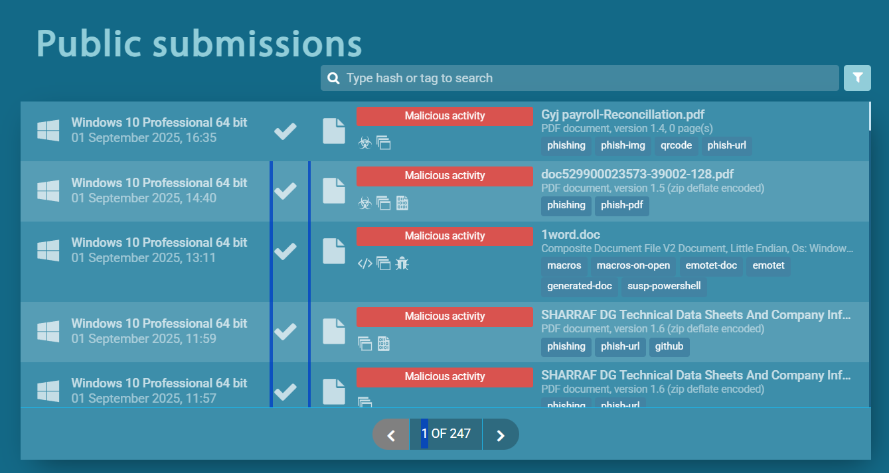
Notes:
Yes, hard to see, but in just a few hours people uploaded malicious documents for analysis

Slide 23

PDF Files Can Be Tricky! So what?
Alas, it is easy to hide malware in PDF files!
Machine Learning could be helpful, but
  Not many data sets available for training
  People who need to catch malicious PDFs may have limited Internet access, or limited CPU power

Slide 24
PDF docs have a tree structure
/Root (Catalog)
|
/Pages
|
---------------------------------------- …
| | |
/Page /Page /Page
| | |
--------- --------- ------------
| | | | | | | | | |
/Contents /MediaBox /Resources /BBox
Attributes of these trees can be measured, and
used as input to predict whether the document is malicious or benign
Notes:
As many of you know, PDF files have a certain structure. Deviations from what is “norma;” may indicate malware

Slide 25
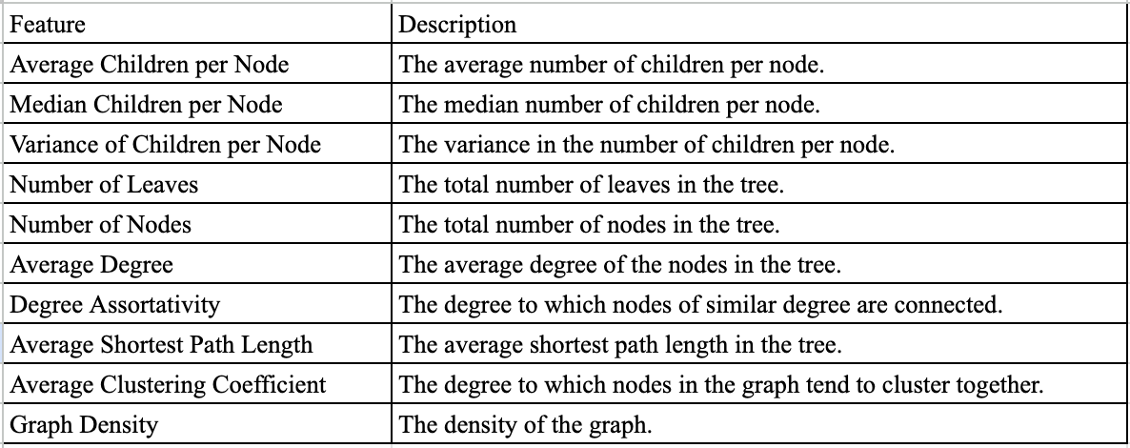
PDF doc attributes --> ML models

Slide 26
PDFRep is a composite dataset
Contagio: a malware repository with 11,173 malicious and 9,000 benign PDF files. (Thanks, Mia Parkour!)
CIC-Evasive-PDFMal2022: with 5,557 malicious and 4,468 benign documents. (link)
GovDoc: Nearly 1M .gov files, from which we curated 155,583 benign PDFs. (link)
VirusShare: A selection of 290,670 malicious PDFs (link)

Slide 27
The obligatory ML slide
The four parts of PDFRep can be combined in various ways:
  Different combinations of the four datasets in training would lead to different results in testing
  Certain combinations in training give better results than using one part alone – e.g. training with benign from Contagio and malicious from PdfRep (all four) did better in testing than other combinations
  Some risk arises from using data from different sources, but…

Slide 28
Tree Structure Features
Notes:
Average descendants per node – not just immediate children
Number of leaves and nodes tend to increase with the length of the document
See the paper, or our KDD workshop paper

Slide 29
Some good news!
In ML in general, the more training data, the better!
Training a model with a small dataset can lead to significant
variance between different samples, potentially resulting in poor performance.
However,

Slide 30
Some good news!
With PDF it seems that the attributes can approximated into a small number of discrete states (bins). This transformation compresses the space of possible values, leading to a reduction in variance.

Slide 31
PDF Summary
Ran Liu demonstrated that it is possible to train a PDF malware detection model, perhaps with a small training set
Executable content within PDF should remain cause for concern
Open documents inside virtual machines! Unless you generated them yourself or received them from a trusted source.

Slide 32
Contributions
“Evaluating Representativeness in PDF Malware Datasets: A Comparative Study and a New Dataset”, R. Liu, R. Joyce, C. Matuszek, C. Nicholas, CyberHunt Workshop, IEEE Big Data, Sorrento, 2023
  Conducted the first comprehensive comparison of PDF malware datasets
  Introduced PDFRep, a new, open-source dataset of PDF malware

Slide 33
Who Needs More Linear Algebra? Everybody!
Much data related to cybersecurity is multidimensional in nature
  Network logs
  Characteristics of malicious binaries
  Execution traces
Such data can be represented in tensors
  But how to represent the data can be tricky
ML can be supervised or unsupervised
  We talk about supervised a lot, but
  Unsupervised methods, such as clustering, can yield insight!

Slide 34

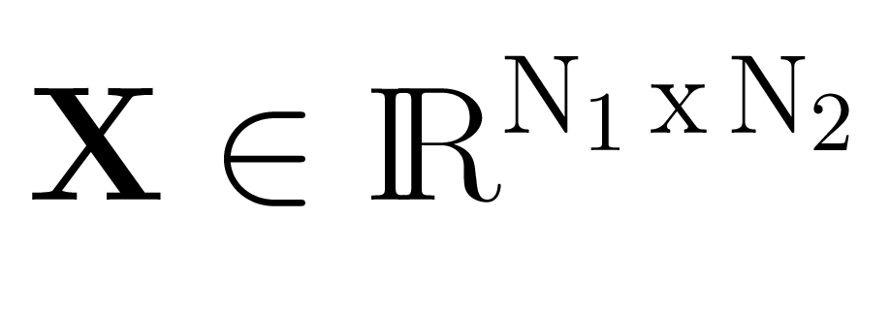
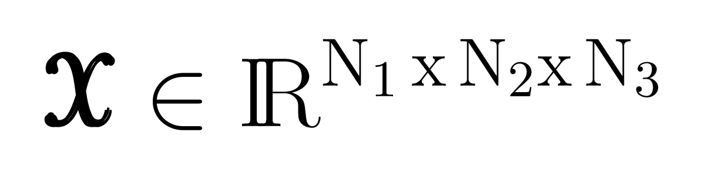
Vector
d = 1
Matrix
d = 2
n-Dimensional Tensor
d >= 3

Slide 35

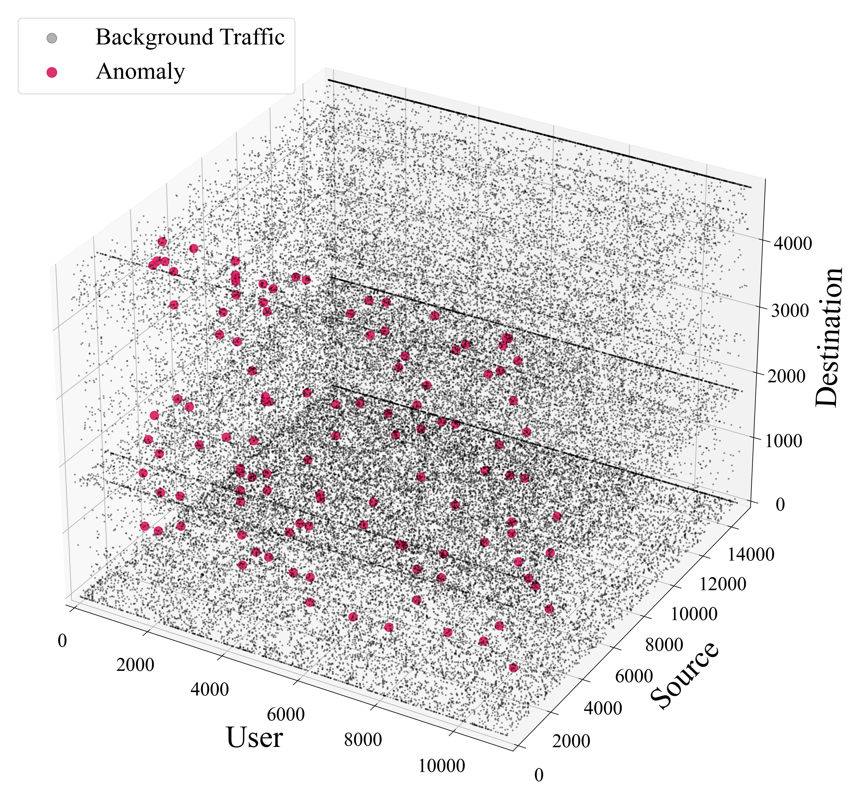


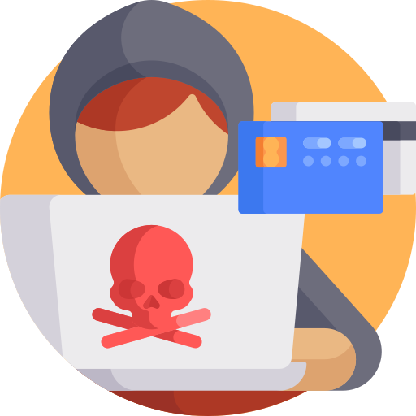

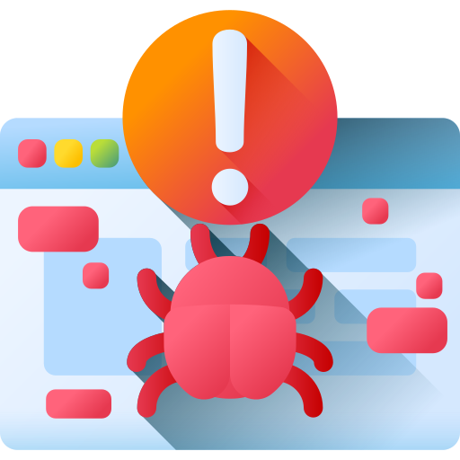




Network Anomaly Detection
User Behavior Analysis
SPAM E-Mail Detection
Credit Card Fraud Detection
Malware/Benign Classification
Malware Family Classification
Novel Malware Detection
Power Grid/SCADA Anomaly Detection

Slide 36
What can we do with Tensors?
Given their multidimensional nature
  We can make simple projections showing one or two dimensions in isolation
  Example: number of network intrusion attempts as a function of time of day
Tensor decomposition lets us better understand dimension as they relate to each other
  Decompose a tensor into some combination of rank-one tensors
  Allows us to see subtle patterns and/or discard noise

Slide 37
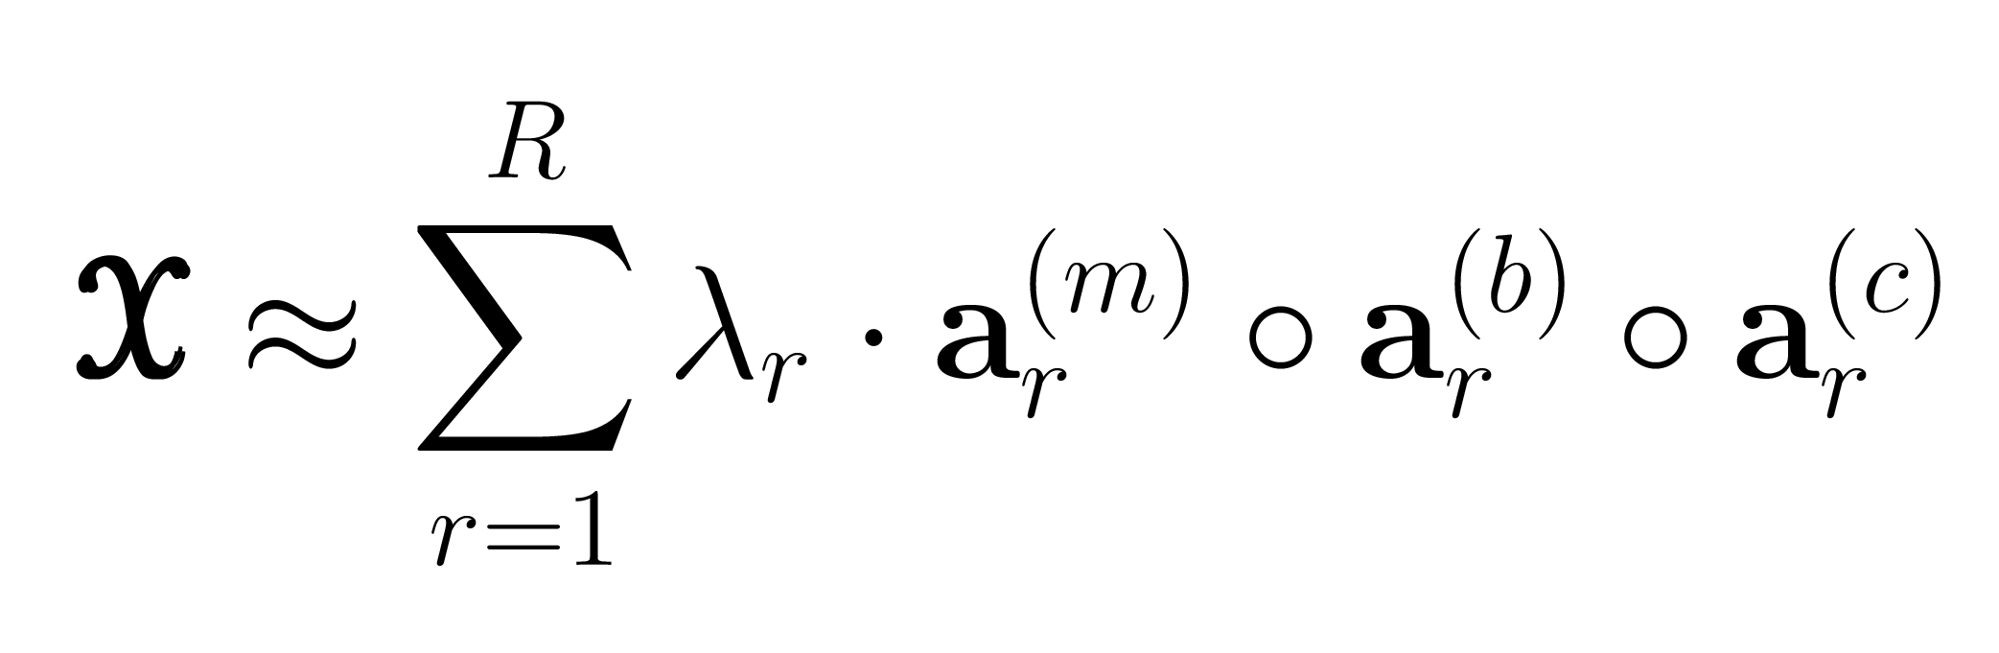
CANDECOMP/PARAFAC Decomposition (CPD)
1
2
R
Note to self: spend very little time on this slide!

Slide 38




Hidden Patterns?
- Hidden patterns and correlations
Useful for actionable results,
modeling data, and decision
making
Credit: Gilligan-Lee, Ciarán. "Causing trouble." New Scientist 246.3279 (2020): 32-35.

Slide 39
Hidden patterns?
Hidden patterns and correlations
Useful for actionable results,
modeling data, and decision
making
Image credit: Gilligan-Lee, Ciarán. "Causing trouble." New Scientist 246.3279 (2020): 32-35.

Slide 40
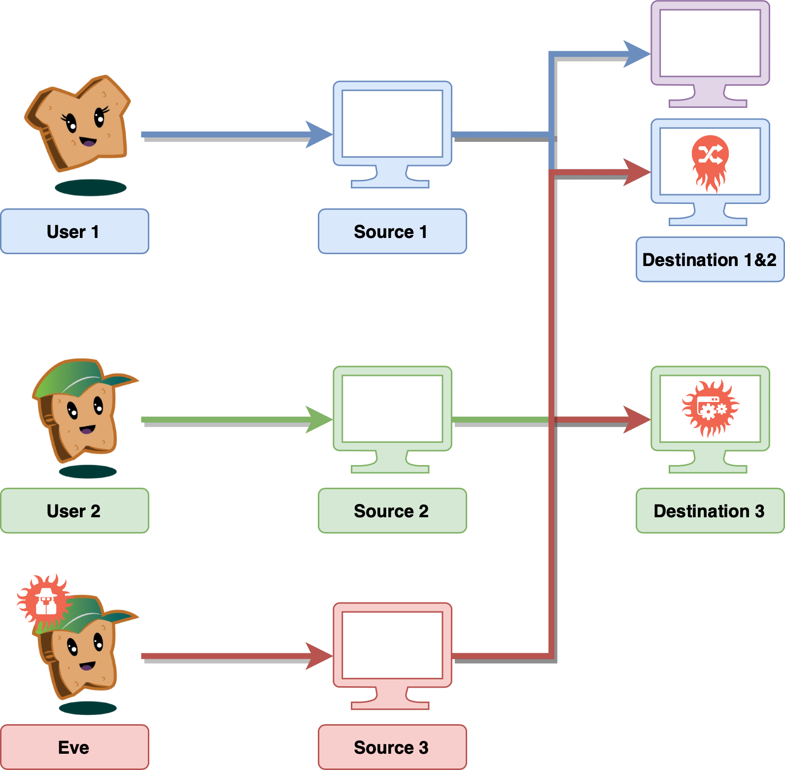
What do we want to detect?

Slide 41
Find Identifying Patterns
Find identifying patterns
This slide has been designed using resources from Flaticon.com
Notes:
We first build an archive of identifying latent software signatures via hierarchical factorization which includes estimation of the number of latent signals^{[1]}.
S1: Extract observational features from labeled malware.
S2: Non-negative factorization of the observational data X which gives us a factor matrix W (k columns are the latent signatures) and H (rows are the magnitudes of each of the k signatures).
S3: Apply a custom clustering which assigns each of the samples to one of the k signature-clusters.
S4: When a uniform cluster is identified, i.e. a cluster which contains specimens from the same family, we add the annotated cluster centroid to our archive of signatures.
Otherwise, we continue with successive factorizations in a hierarchical manner to separate the mixed latent signatures.

Slide 42





Selective Classification (Reject-option)
Self-awareness for ML model to know when it does not know
“the more I learn, the more I realize how much I do not know.” - Albert Einstein
“If knowledge is power, knowing what we do not know is wisdom” ^{[8, 11]}
Withdraw from making a decision for uncertain predictions using confidence
Useful when a mistake is expensive
Enable knowledge discovery: novel malware families
This slide has been designed using resources from Flaticon.com

Slide 43
Random Forest of Tensors (RFoT)
Bulk Semi-supervised Malware Family Classification
Tensors are useful!
Semi-supervised methods do help!
Low quantity of labelled data
– no problem!

Slide 44
Distribute the Computation
Node 1
Node 2
Node 1
Node 2
Node 3
Node 4
Node 5

Slide 45
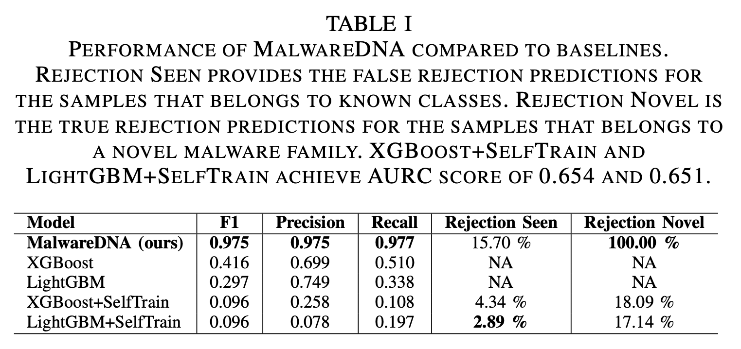
Experiments
Using the EMBER-2018^{[9]} dataset, we randomly sample 1,000 benign-ware, and malware specimens from families:
  Ramnit, Adposhel, Emotet, zusy
  We select Ramnit to represent a novel family.
We achieve AURC* score of 0.02 :
At ~84% coverage: ~0.975 F1
Correctly identify ~100% of Ramnit as novel
Surpasses supervised and semi-supervised baselines
*Area Under the Curve of Risk-Coverage^{[10]}

Slide 46
New and Ongoing, part 1
Malware Clustering (e.g. DocEng’25 author Raguvir)
  Did we mention labelled datasets?
Software Metrics applied to malware source code
Characterizing Ransomware Behavior in Active Director
Symbolic Execution applied to malware analysis
Compression and Similarity

Slide 47
New and Ongoing, part 2
Future Work in Malware Analysis
  Look at those dynamic analysis questions where tensor decomposition and deep learning could be applied
  Make sure these ideas work at scale
  But there is doubt over how much we can gain beyond static analysis!

Slide 48
New and Ongoing, part 3
AI generated code, oh my!
  Can it be trusted?
    No, not yet, and not fully
  Are programmers obsolete?
    Only if they were already incompetent!

Slide 49
Preliminary Conclusions
Charles wishes he had learned more linear algebra ☺
But students know enough about machine learning (so Charles does not need to)
Great help to focus on mission and concerns of sponsor(s)
  Dealing with malware
  Dealing with large amounts of heterogeneous data

Slide 50
Closing Remarks
Important that doctoral students learn about white papers and grants
Taking a full-time position before finishing your dissertation can be a really good idea! Or bad!

Slide 51

Thank you! Questions?
Credit once again to our hard-working students!
nicholas@umbc.edu

